Slide 1
Using OpenStreetMap Building Footprints Data for Population Distribution Model: A Case Study in Cavite, Philippines
State of the Map 2019 Heidelberg, Germany
Scholar Lightning Talk Sept. 22, 2019

Slide 2
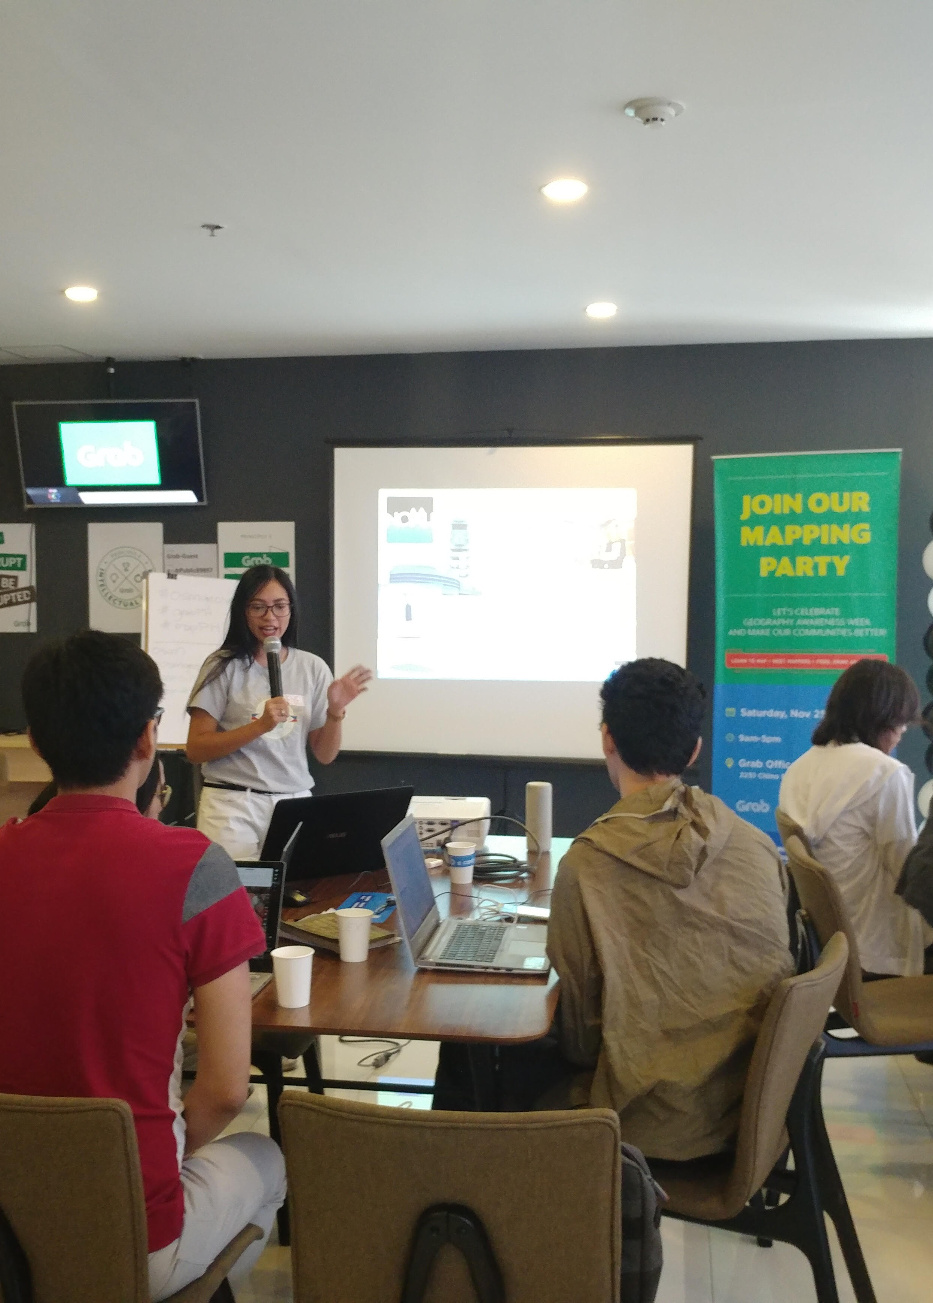





HELLO!
I am Feye Andal
GIS Specialist/Researcher, UP Resilience Institute
Volunteer, OpenStreetMap Philippines
@feyeandal

Slide 3
RATIONALE
Philippines has undergone rapid urbanization and population growth but existing spatial population distribution data is still lacking
Spatially accurate population distribution maps are essential for disaster risk assessment (from awareness to response)

Slide 4
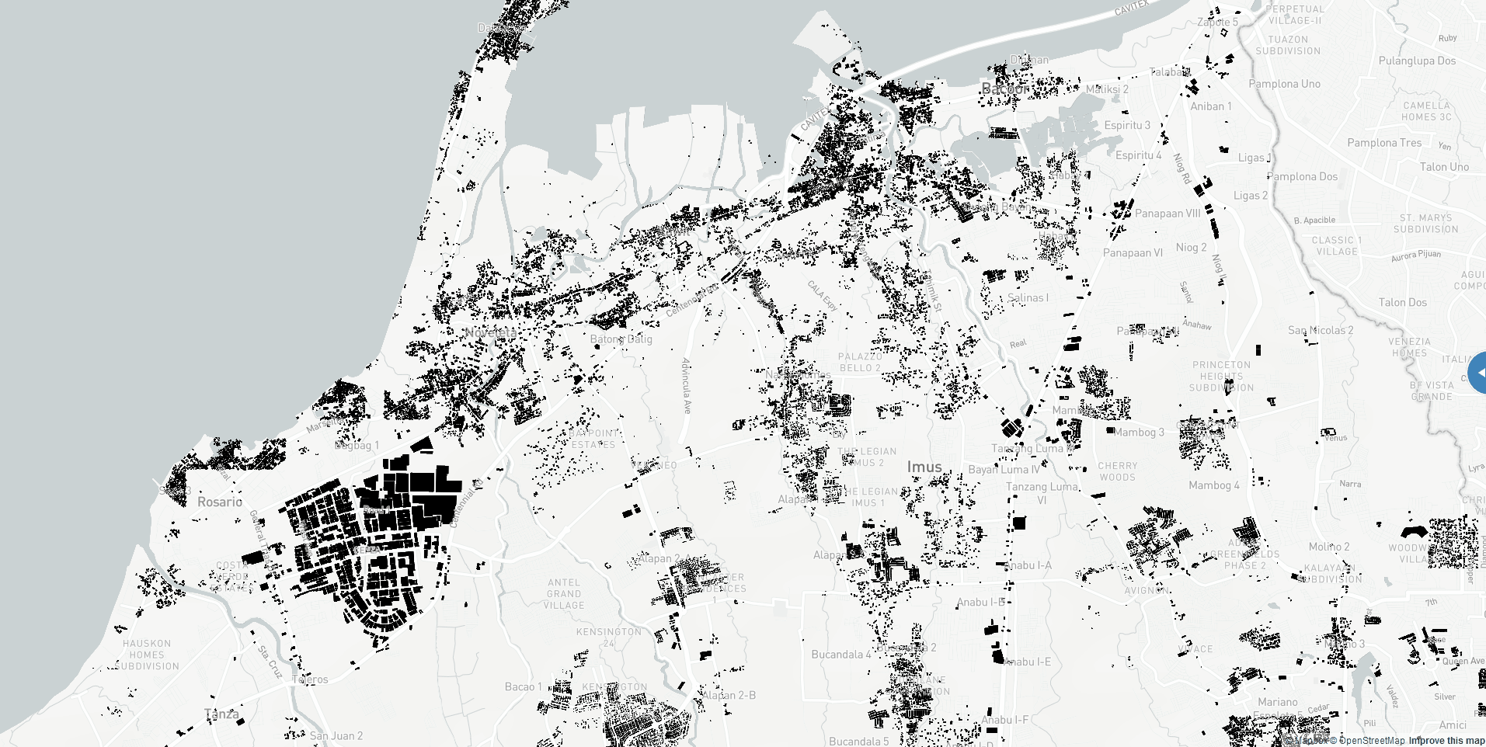

Slide 5
Volunteered Geographic Information (VGI)
A geographic information collected and shared voluntarily by the general public (e.g. OpenStreetMap)

Slide 6
METHODS
download and process 2015 Census of Population (PSA)
digitize and validate OSM building footprints data
(JOSM)
extract OSM buildings (Geofabrik)
run Population Distribution Model (arcpy)

Slide 7
OUR PROCESS IS SIMPLE
generate 10m grids of brgy boundary
intersect 10m grids to OSM buildings
spatial join urban grids with brgy boundaries
frequency analysis
join fields of brgy boundary and point counts
add field to brgy boundary
calculate field (popn2015/
frequency)
join population field of brgys and brgy boundary then spatial join
convert polygon to raster
project raster (optional)

Slide 8
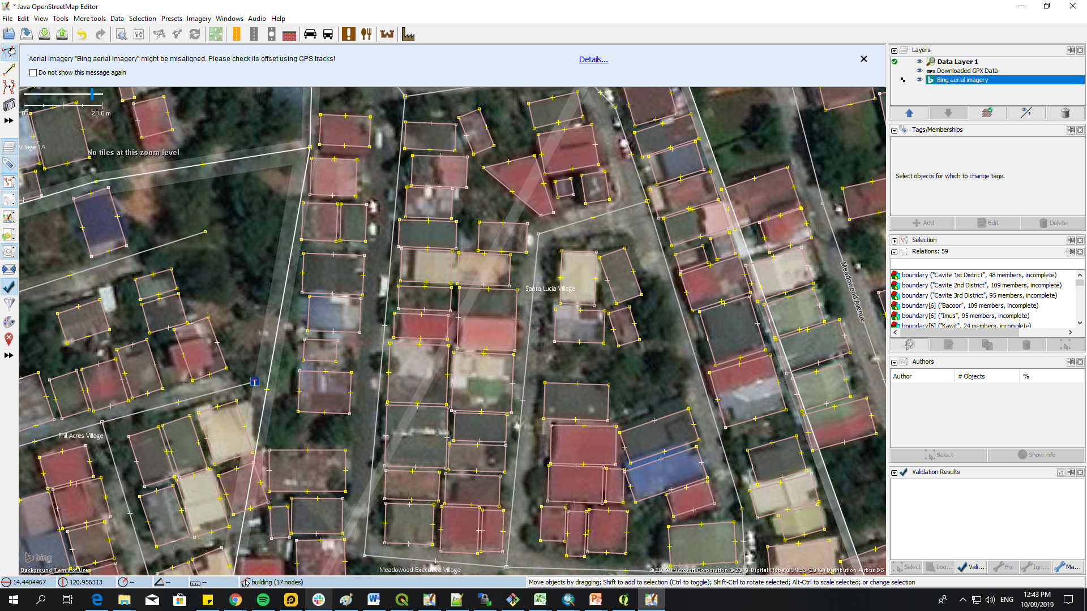
digitizing and validating OSM building footprints via JOSM

Slide 9
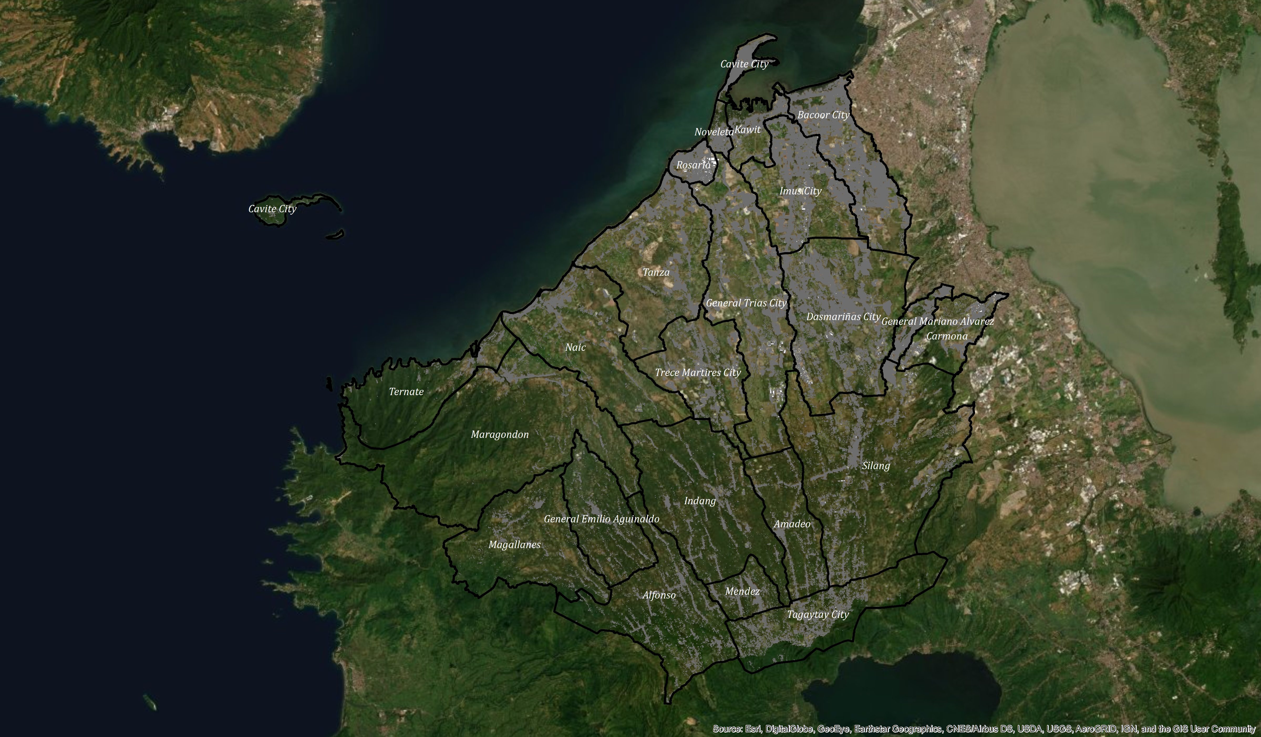
OSM Building Footprints (Jan 2019)

Slide 10
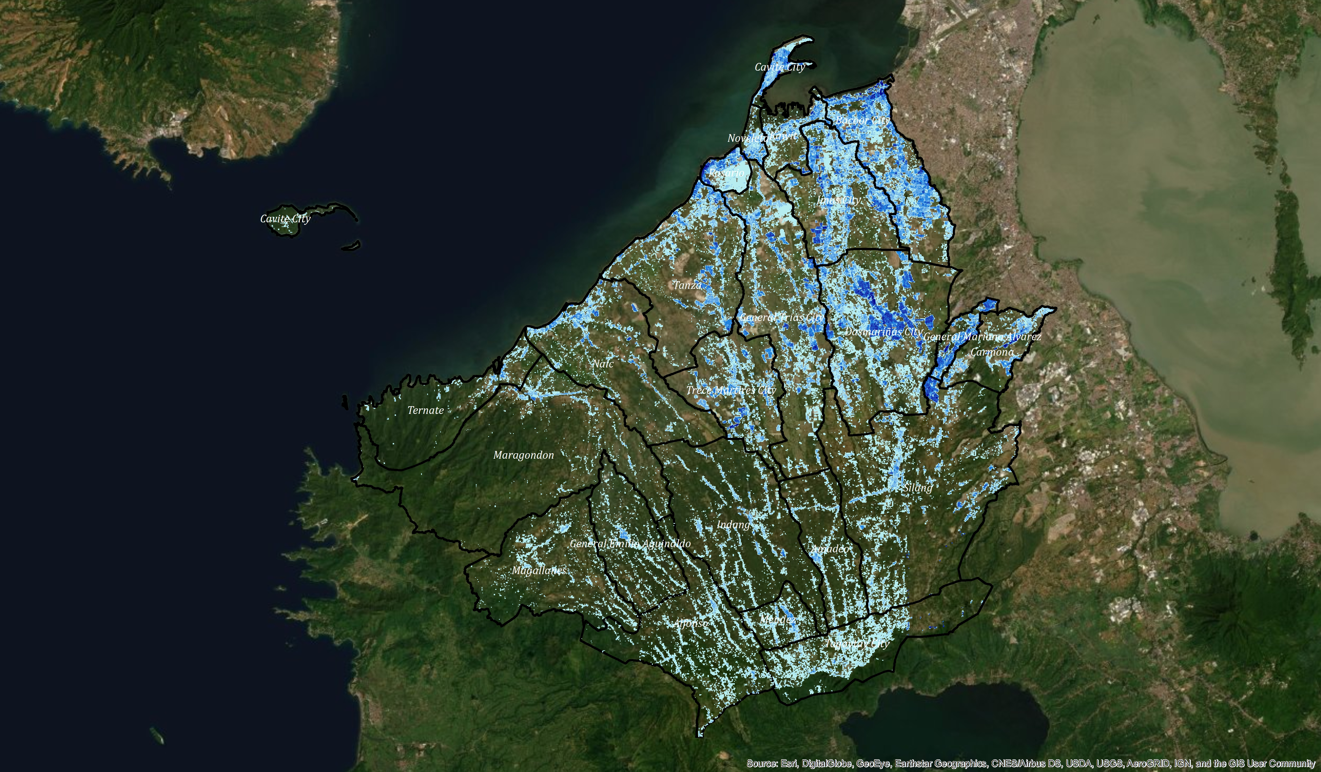
RESULTS:
generated Population Raster

Slide 11
FINDINGS
The results showed that OSM database can be used to produce population distribution map at detail scale
Although OSM is useful for generating population map, it has many weaknesses such as misidentification of buildings, and topology of building footprints, that is why validation of OSM data is important

Slide 12
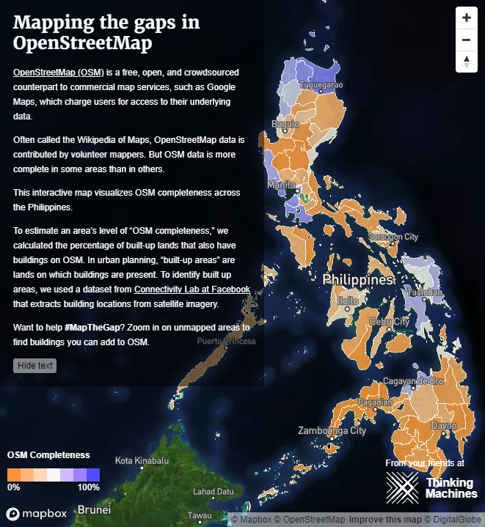
CHALLENGES
Achieving high completeness , consistency, and accuracy of OSM data is time-consuming and labor-intensive

Slide 13
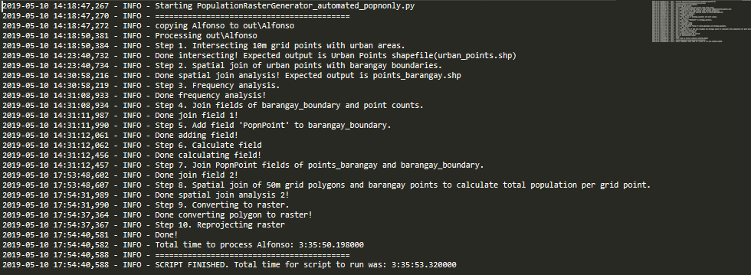
CHALLENGES
The run time of the population distribution model is long (average run time is ~4hrs)

Slide 14
Sample Analysis of Population Map from OSM

Slide 15
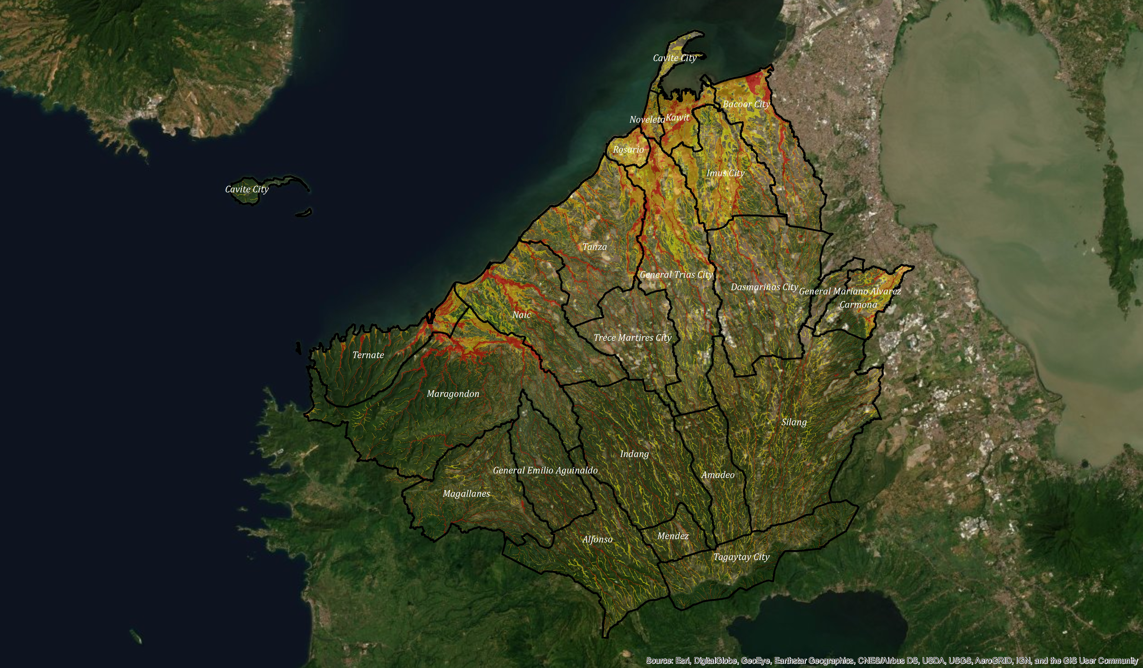
100-Year Flood Hazard (UP NOAH)

Slide 16
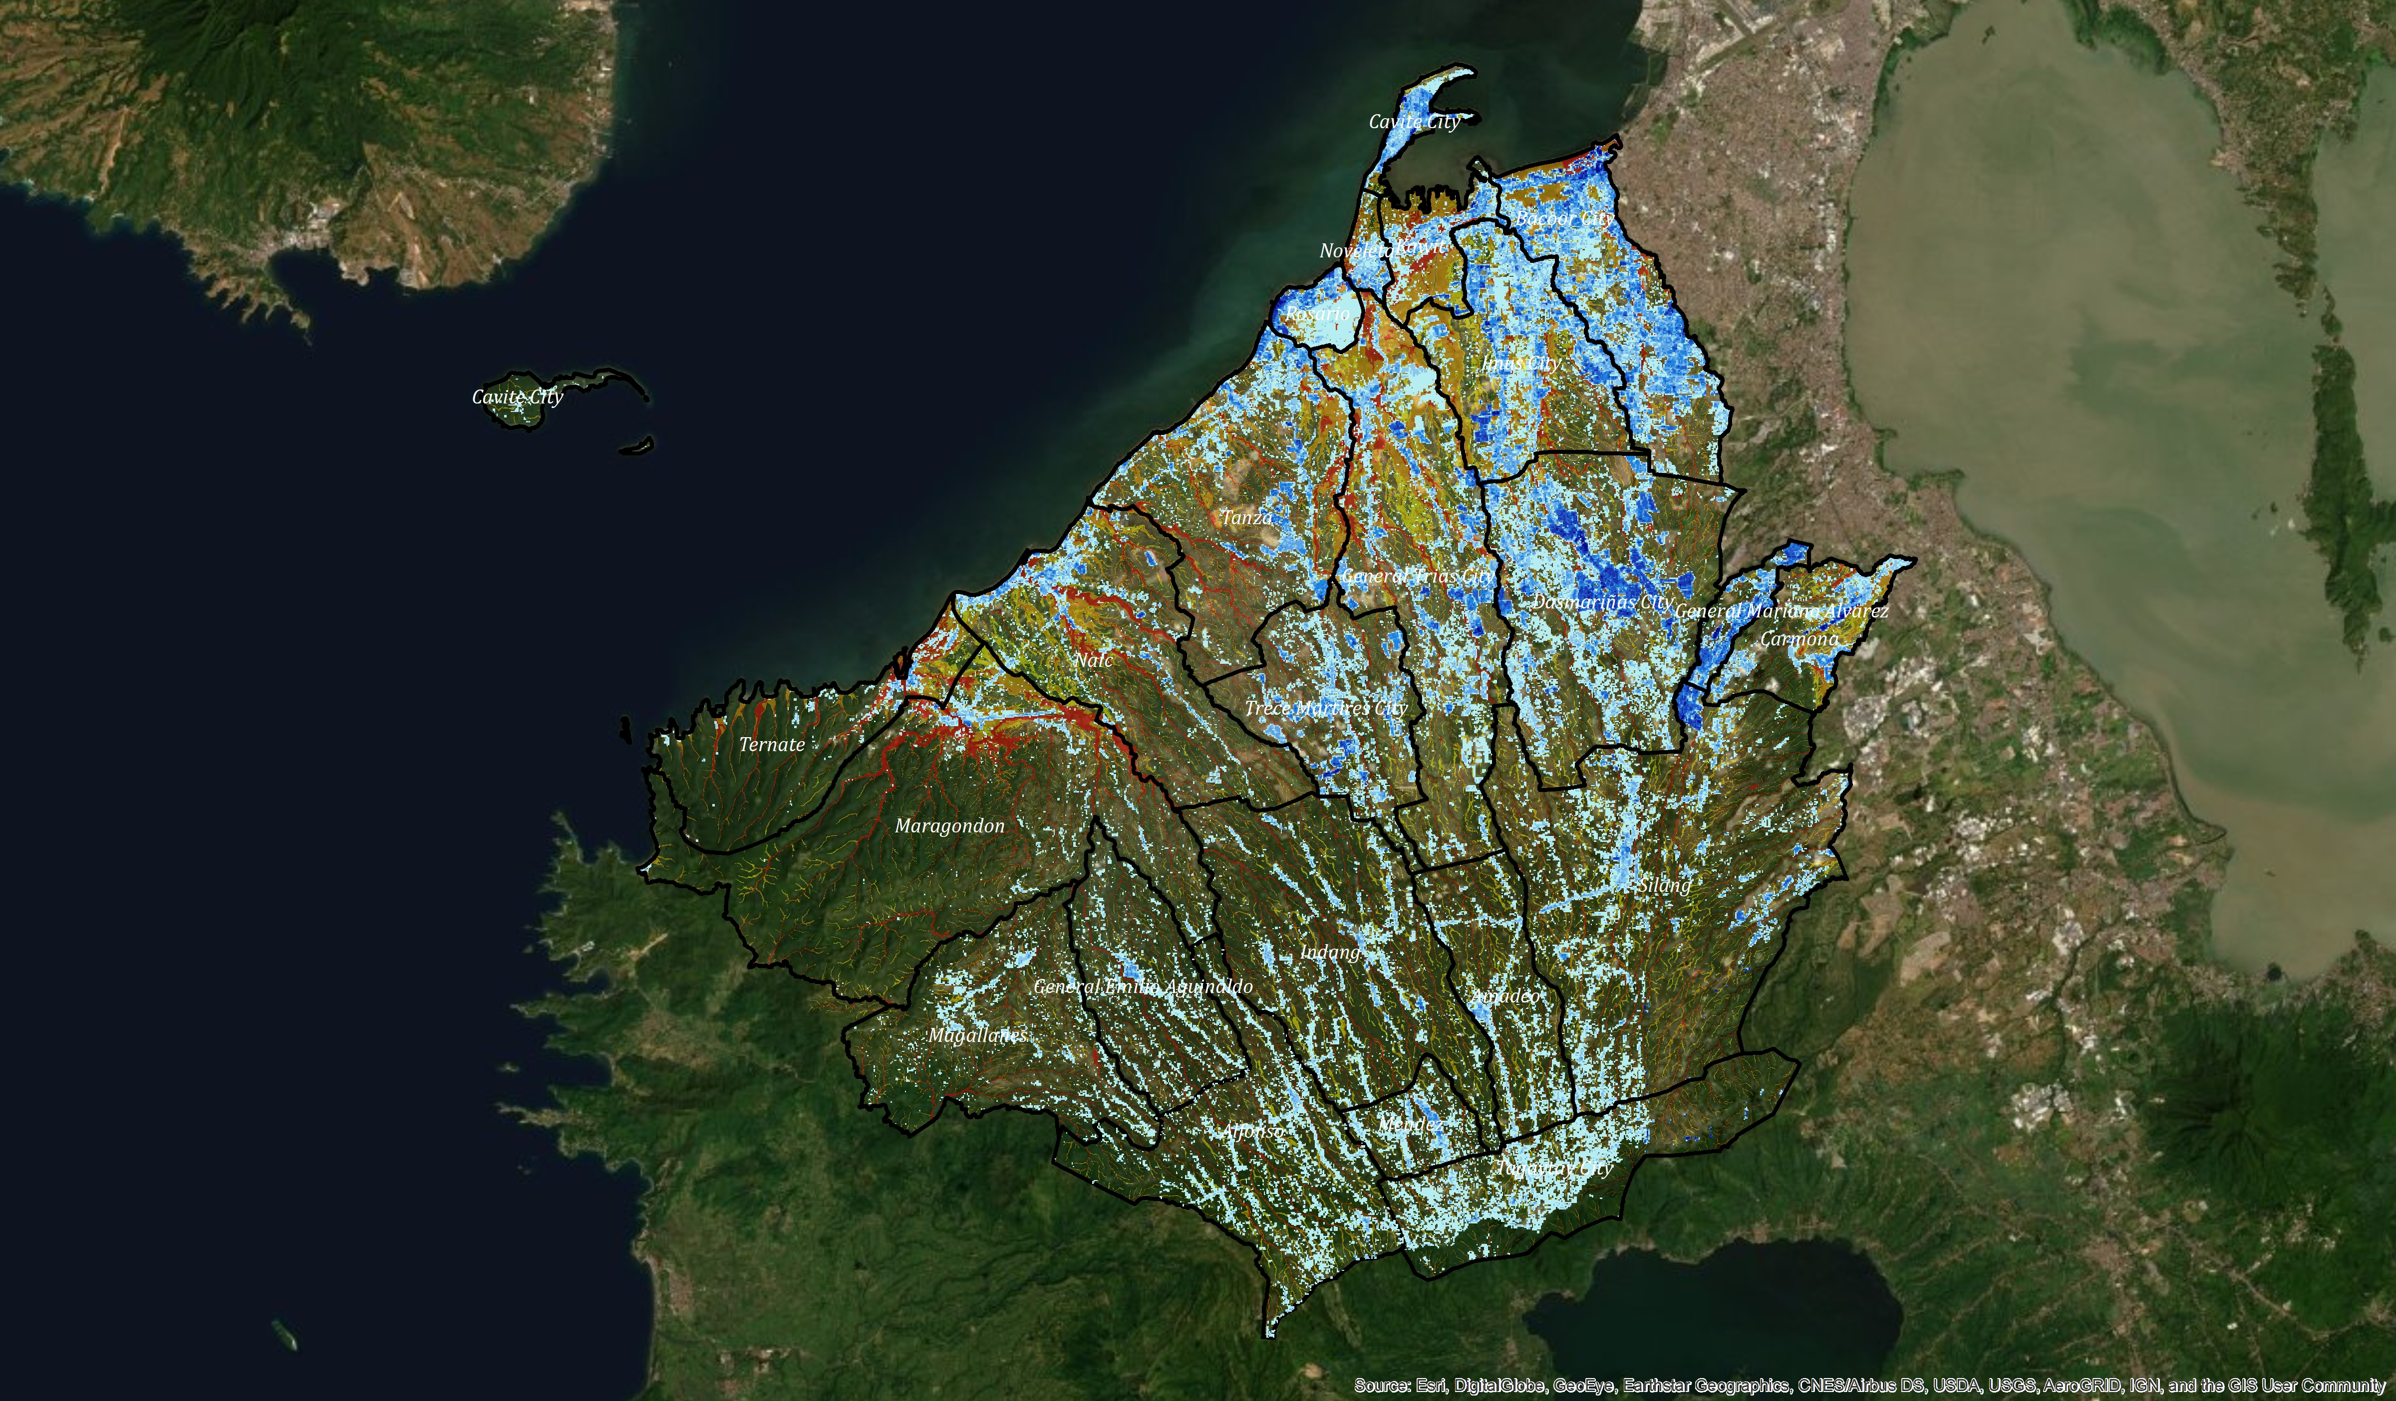
Overlay Analysis of Flood Hazard and Population

Slide 17
3,678,301
total population in Cavite as of 2015

Slide 18
1,684,735
1,387,293
527,102
low (<0.5m)
POPULATION
EXPOSED TO
100-YEAR FLOOD
moderate (0.5-1.5m)
high (>1.5m)

Slide 19
1,480,876
total population not exposed to 100-year flood hazard

Slide 20
THANKS!
Any questions?
You can find me at:
@feyeandal
dhandal@up.edu.ph

Slide 21
REFERENCES:
Rizqihandari, N. and Indratmoko, S. (2016). Using OpenStreetMap Data for Population Model. Advances in Social Sciences, Education and Humaities Research, Vol 79
Bonafilia, et. al (2019) Mapping for humanitarian aid and development with weakly and semi-supervised learning. https://ai.facebook.com/blog/mapping-the-world-to-help-aid-workers-with-weakly-semi-supervised-learning/

